Slide 1
History of AI
Professor Dr. Loc Nguyen, PhD, Postdoc
Loc Nguyen’s Academic Network, Vietnam
Email: ng_phloc@yahoo.com
Homepage: www.locnguyen.net

Slide 2
Abstract
What is philosophy? What is math? What is informatics? What is biology? These questions have their own answers, of course. However, this research will connect all of them together with a surprised association with artificial intelligence (AI) along with AI history. Moreover, you will be much more surprised with a research proposal of the unification of matter and spirit which means that there is no separation between matter and spirit. Of course, this proposal is not strict scientific statement but I hope that it is an interesting thinking.

Slide 3
Table of contents
Noble math
Valiant physics
Discrete informatics
Fragmented AI
Marvelous biology
Mysterious God
Great Nature

Slide 4
Noble math
I turn history stream back to ancient age around 500 BC in ancient Greek which is the cradle of Western civilization, the age of three great philosophers such as Socrates (470 – 399 BC), Plato (427 – 348 BC), and Aristotle (384 – 322 BC). I cannot focuses on philosophical theories and ideologies here but I assume that the centers of philosophy move and swing among epistemology (self-consciousness), reasoning, and logic.
But what are consciousness, reasoning and logic? The answer is laying in the huge & complex network of philosophical theories and ideologies. However, the core & shadow meaning is that reasoning and logic reflex the abstraction of nature within human thinking, that I would like to mention. I call temporally such abstraction of nature as abstraction of things at the first degree.
Pythagoras (570 – 495 BC), another great Greece philosopher, invented Pythagoras theorem (c² = a² + b²) that connects geometry and arithmetic where both of geometry and arithmetic are abstraction of things at the second degree.
Indian and Chinese (400 BC – 1200 AD) discovered numeric system and arithmetic, especially zero number. It is asserted that the composition of geometry and arithmetic is the first abstraction of science, which is in turn is the second abstraction of human thinking.
Therefore, there is no doubt that there is a tight relationship between philosophy and mathematics where philosophy is the top of human epistemology and of course, math is the top of science, which asserts that math is noble.

Slide 5
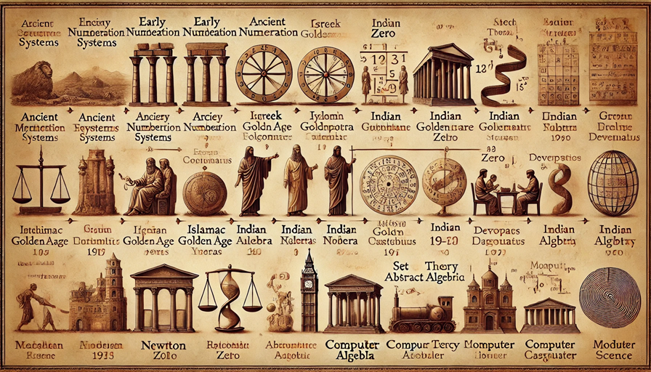
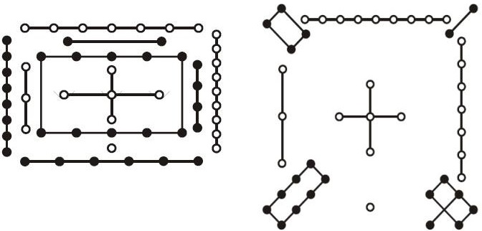
Noble math
After math is forked into specialized branches such as algebra, analysis, geometry, topology, probability, discrete math, and applied math, math still keeps its high degree of abstraction with abstract algebra and functional analysis.
About the high abstraction of geometry and arithmetic, it is interesting to mention a fantastic aggregation of philosophy, math, and mystery. This is Hetu Luoshu (河图洛书) or Nine Halls Diagram to explain and model the universe by numbers and figures, which occur on dragon horse and deity turtle in Chinese legend. Hetu Luoshu are also the origin of the Book of Changes which is called an Eastern strange book that describes, explains, and models society activities and natural phenomena by two basic features such as positivity and negativity.
Wikipedia
ChatGPT

Slide 6
Noble math
ChatGPT

Slide 7
Valiant physics
After noble math as the highest abstraction of nature goes into human brain, there is a demand that human needs to go out the world so as to view carefully the world in detail. This demand, in turn, requires a great power so that noble math has to be transformed into valiant physics.
Isaac Newton (1642 – 1726) built up the first pillar of classical physics with Newton’s laws of motion and Newton’s law of universal gravitation. Albert Einstein (1879 – 1955) built up the second pillar of modern physics with Theories of Relativity. Both Newton and Einstein are great mathematician too because their theories push noble math into the nature with the strength of imagination. Note, works of Newton and Einstein can be modeled by mathematical equations (F = Gm₁m₂/r², E = mc²,…).
From departure point of Theories of Relativity, quantum theory (1900s – now) and dark matter/energy theory (1930s – now) dive into indefinability and mystery of matter world. Anyhow such indefinability and mystery relates implicitly to the relationship between matter and spirit as well as the relationship between human and universe with regards to epistemology (self-consciousness) which is one of important subjects of philosophy.

Slide 8
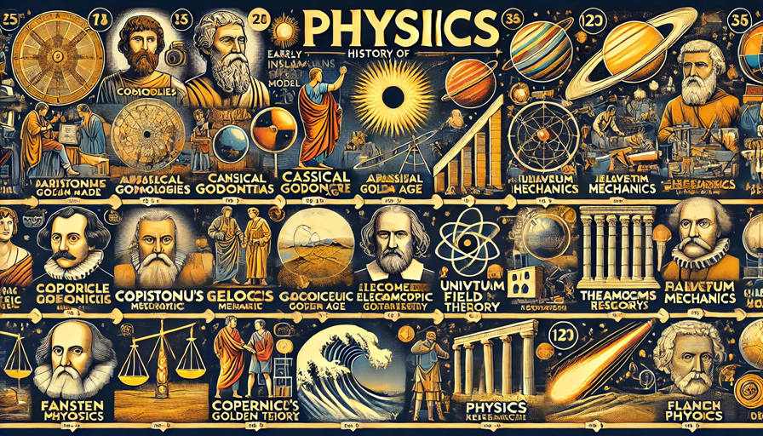
Valiant physics
ChatGPT

Slide 9
Valiant physics
It is easy to understand the important relationship between physics and math but another important relationship in physics is the relationship between matter and spirit. Therefore, physics does not go beyond philosophy ever.
Modern physics researches not only the universe but also human existence. As a result, there are three big questions for physics: 1) where do we come from, 2) where do we go to, and 3) what is matter. The first question is not totally answered yet because of the third question “what matter is”. In next slides, I propose a unification of matter and spirit.
To answer the three big problems is to require a lot of power and efforts. It is interesting that the third question “what matter is” can relate to epistemology which is formerly subject of philosophy.

Slide 10
Discrete informatics
In physics, math would like to realize nature or universe inside human by modeling and description with expectation that there is no degradation. Fortunately, this derives many great successes in technology, which serves human life and human civilization. Unfortunately, there remains problems about human epistemology, for instance, the relationship between matter and spirit.
According to another realization of math in another axis, informatics reduces the world of math into the world of information. Moreover, the world of information is realized by discretion which can be considered as a degradation so that informatics can exist inside human brain. Therefore, discretion is the most essential of informatics. Without discretion, informatics cannot be realized. It is possible to say that informatics maps the world of nature (source) into the world of information (target) via the world of math (middle) with note that the world of math (middle) tries to model the world of nature (source) by physics without assertion of completion.

Slide 11
Discrete informatics
Although informatics is based on discrete math, it has the three axes such as theoretical axis, practical axis, and connective axis in which theoretical axis is binary number system and practical axis is Turing machine whereas connective axis is network system.
From the three axes, informatics is developed into two branches such as computational branch and engineering branch. Within computational branch, informatics aims to develop itself in both theory and practice, which includes programming, computing, database, data mining, information system, machine learning, and artificial intelligence. Within engineering branch, informatics aims to apply itself into industry so as to produce service products, which include programming, software engineering, and networking. Note, some sub-fields like programming exist in both computational branch and engineering branch.
Except philosophy not requiring physical equipment, all math, physics, and informatics require some physical equipment to delegate itself to users in use. Moreover, physical equipment for informatics is much more essential, which is a computer representing hardware of informatics. When focusing on incorporation of informatics and computer, informatics is called computer science but the meaning of computer science is more complicated because computer science relates to both software and hardware whereas informatics focuses on features of information and applied math. When focusing on information and application of information, informatics is called information technology.

Slide 12
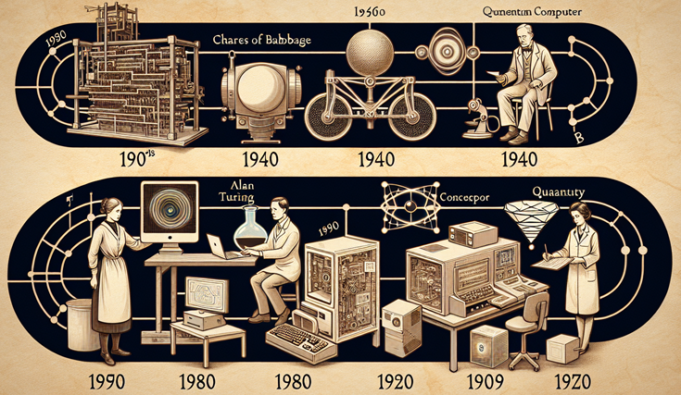
Discrete informatics
History of computer science - Alayna

Slide 13
Fragmented AI
Both data mining and machine learning (sub-fields of computer science) draw/extract or learn knowledge from raw data and such knowledge is represented in form of models and rules but machine learning focuses on a process of inference. Moreover, machine learning can derive automatic instructions without intervention of programmers. Therefore, I assume that machine learning is more evolutional than data mining and data mining is more basic than machine learning. Both data mining and machine learning use the statistical tools but machine learning moves forward applying advanced mathematical knowledge. So, machine learning aims to artificial intelligence (AI).
In other words, machine learning is the first step of AI or AI is based on machine learning. In common definition, AI aims to allow computer to do tasks having abilities approximated to human intelligence. In other words, AI is building a bridge from computer to human brain and of course, this bridge is infinite, at least in current age. With this great ambition, AI is both future and purpose of computer science. However, because the limitation of machine learning is caused by two reasons: 1) mathematic knowledge may be not enough in some narrow subjects of machine learning, and 2) mathematic knowledge is too huge to be implemented in computer science with our current level of technology, AI is currently limited too.
Currently, there is a unconscious solution for the limitation problem of AI is that AI borrows knowledge from three sources: 1) knowledge from applied math, 2) knowledge/wisdom from nature, and 3) predefined assumption called heuristic assumption from human. Note, such heuristic assumption is knowledge/wisdom from human not concerning math. This is the reason that I assert that AI is fragmented because of the three knowledge sources of AI.

Slide 14
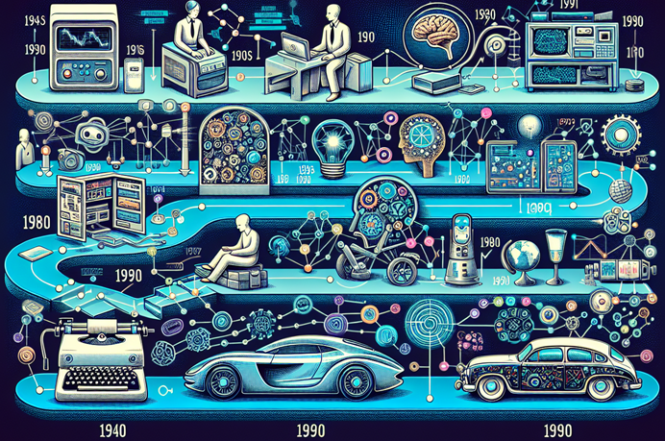
Fragmented AI
History of AI - Alayna

Slide 15
Fragmented AI
Because of its fragment, AI always has a trend to incorporate some different domains into a larger integrated model when solving some problem. But what is the reason of such integration? The answer is that AI aims to some convergence although such convergence may approach many (more than one) converged points.
For illustrating the integration, deep learning depends on artificial neural network (ANN) which in turn is association of graph theory and applied optimization. Graph theory and applied optimization are knowledge from math. Moreover, it is admirable that ANN also depends on natural knowledge about nervous system of human, associated with another assumption that the complexity of links among biological neurons will arise some intelligence.
Anyhow, AI is going beyond the knowledge-extracting ability of machine learning and its convergence is going according two ways such as reproduction way and self-thinking way because current peaks like deep learning still operate in the knowledge-extracting space. Reproduction way is being represented by generative AI (GenAI) and self-thinking way is being represented by artificial general intelligence (AGI). Such two ways “reproduction way” and “self-thinking way” relate to AI imitation of realistic biological evolution.
For human, product of reproduction fitness is people themselves and product of self-consciousness is abstraction of things like math, physics, informatics, etc. For AI as abstraction of things, product of reproduction way is abstraction of things too but if so, there will be a question “what is product of self-thinking way?”. The answer “product of self-thinking way is abstraction of abstraction of things” will be unclear unless we can explain unwillingly that abstraction of abstraction of things is a secondly derived AI. However, the question “how about the degree of abstraction in secondly derived AI” has seemly no answer because the secondly derived AI is still AI for human.

Slide 16
Fragmented AI – reproduction way
Recall that reproduction way is being represented by generative AI (GenAI) but GenAI is not reproduction way, totally. Anyhow I will illustrate reproduction way by GenAI.
There are two main generative models of GenAI: 1) generative model that applies deep neural network into generating digital content such as sound, image, and video, and 2) generative model that applies large language model into generating natural language texts understandable by human. Firstly, deep generative model (DGM) for digital content generation is described.
Given random variable vector x = (x₁, x₂,…, x_{m})^{T} presenting any digital artifact or any digital data such as image and sound, let P(x) be probability density function (PDF) which is intractable. Suppose there is another random variable vector z = (z₁, z₂,…, z_{n})^{T} so that PDF of z denoted P(z) is tractable. Moreover, it is most important that suppose there is a function called generator g(z | Φ) = x that maps tractable data z to intractable data x where Φ is generator parameter.
The ultimate purpose of any DGM is to estimate parameter Φ so as to determine generator g(z | Φ) where g(z | Φ) is represented by a deep neural network (DNN) whose weights are Φ.

Slide 17
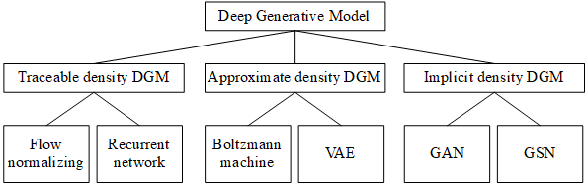
Fragmented AI – reproduction way
The two problems of constructing DGM are 1) how to train generator DNN g(z | Φ) and 2) how to qualify such training task which often relates to another optimization task or another training task. Consequently, there are two DGM approaches: 1) DGM specifies explicitly generator PDF P(x | Φ, z) and 2) vice versa. In group of explicit PDF approach, there are two built-in approaches: 1) tractable density DGM specifies explicitly well-known distributions for generator likelihood and 2) approximate density DGM tries to estimate approximately generator PDF P(x | Φ, z). In general, there are three main approaches for constructing DGM such as tractable density DGM, approximate density DGM, and implicit density DGM which are mentioned in next sections. Following figure depicts taxonomy of DGM (Oussidi & Elhassouny, 2018, p. 7) by Goodfellow.

Slide 18
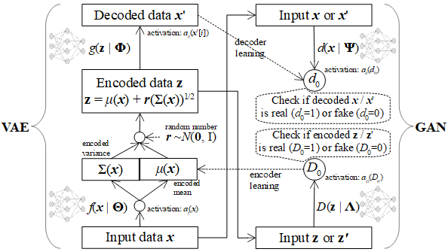
Fragmented AI – reproduction way
Two popular approaches in deep generative model (DGM) are Variational Autoencoders (VAE) and Generative Adversarial Network (GAN). Both VAE and GAN have their own strong points although they share and imply underline theory of statistics as well as incredible complex via hidden layers of deep neural network (DNN). In (Nguyen, 2024), I try to unify VAE and GAN into a consistent and consolidated model called Adversarial Variational Autoencoders (AVA) in which VAE and GAN complement each other, for instance, VAE is a good data generator by encoding data via excellent ideology of Kullback-Leibler divergence and GAN is a significantly important method to assess reliability of data which is realistic or fake. In other words, AVA aims to improve accuracy of generative models, besides AVA extends function of simple generative models.
AVA architecture

Slide 19
Fragmented AI – reproduction way
Recall that there are two main generative models of GenAI: 1) generative model that applies deep neural network into generating digital content such as sound, image, and video, and 2) generative model that applies large language model into generating natural language texts understandable by human. Generative model that applies large language model is described now.
Large language model (LLM) is the model for natural language processing (NLP) with huge text corpus as training data. The most popular LLM now is transformer and so I focus on transformer here. Transformer is the highly abstract and complicated version of function y = f(x | Θ) which is implemented by deep neural network (DNN).
Although transformer can be applied into many areas, especially machine translation and computer vision, this report focuses on statistical machine translation (STM) because complex and different objects x and y in STM transformer are two sentences in two different languages where x is source language sentence and y is target language sentence. If ordering of elements x_{i} / y_{i} in vector x / y specifying sentence is concerned as ordering of words x_{i} / y_{i} in a sentence, transformer will relate to sequence generation. Therefore, transformer as well as STM are inspired from sequence generation which, in turn, relates to recurrent neural network (RNN) as well as long short-term memory (LSTM) because sequence generation models are often implemented by RNN or LSTM.
Firstly, sequence generation is introduced before transformer is described.

Slide 20
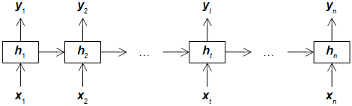
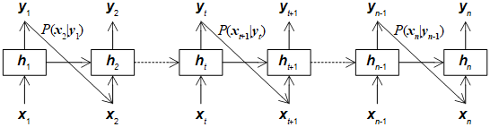
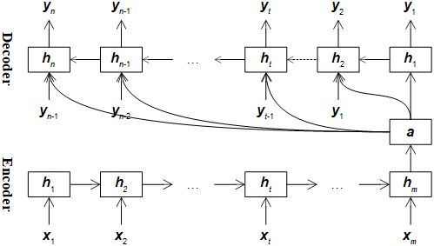
Fragmented AI – reproduction way
RNN generation model
RNN prediction model
Encoder-decoder model with fixed-length context a

Slide 21
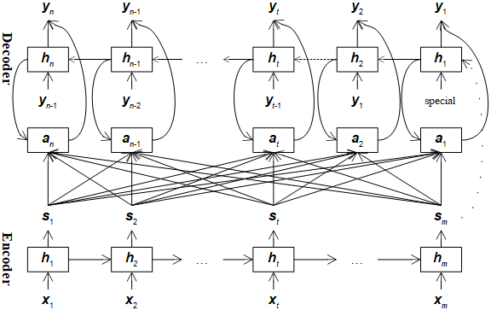
Fragmented AI – reproduction way
When encoder-decoder model is developed, context vector a becomes a so-called attention. The main difference between context vector and attention vector is that attention vector is calculated dynamically (customized) for each decoder state. Moreover, that context vector has fixed length restricts its prospect. Anyhow, attention mechanism fosters target sequence to pay attention to source sequence. Following is encoder-decoder model with attention.

Slide 22
Fragmented AI – reproduction way
Transformer, developed by Vaswani et al. (Vaswani, et al., 2017) in the famous paper “Attention Is All You Need”, has also attention mechanism and encoder-decoder mechanism like the aforementioned generation model that applies recurrent neural network (RNN) and long short-term memory (LSTM) but transformer does not require to process successively tokens of sequence in token-by-token ordering, which improves translation speed.
Moreover, another strong point of transformer is that it has self-attention which is the special attention that concerns internal meanings of its own tokens. Transformer supports both attention and self-attention, which fosters target sequence to pay attention to both source sequence and target sequence and also fosters source sequence to pay attention to itself.
Each encoder as well as each decoder in transformer are composed of some identical layers. Each encoder layer has two sublayers which are multi-head attention sublayer and feedforward sublayer whereas each decoder layer has three sublayers which are masked multi-head attention sublayer, multi-head attention sublayer, and feedforward sublayer. Every sublayer is followed by association of residual mechanism and layer normalization, denoted as Add & Norm = LayerNorm(X + Sublayer(X)). The residual mechanism means that sublayer Sublayer(X) is added with its input as the sum X + Sublayer(X). Note, Sublayer(X) can be attention sublayer or feedforward sublayer. The layer normalization is to normalize such sum. Next figure summarizes transformer developed by Vaswani et al. (Vaswani, et al., 2017, p. 3).

Slide 23
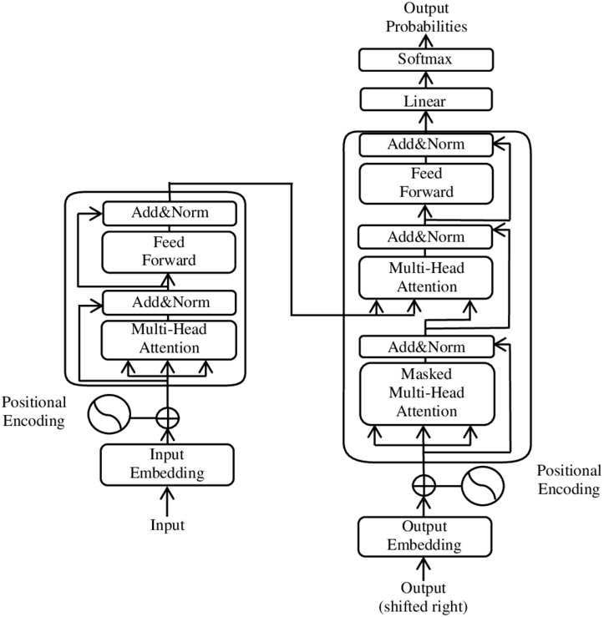
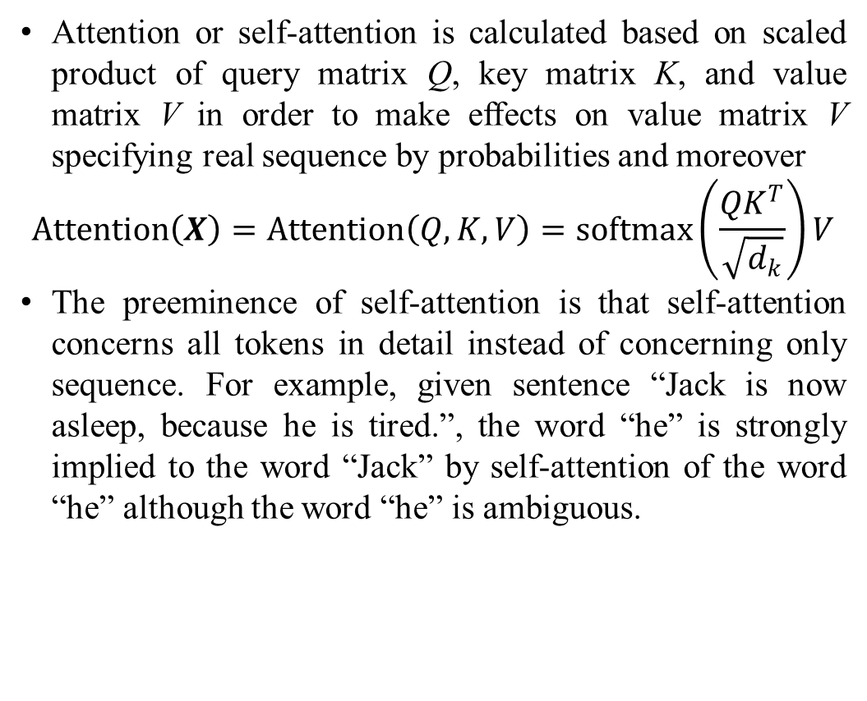
Fragmented AI – reproduction way
Attention or self-attention is calculated based on scaled product of query matrix Q, key matrix K, and value matrix V in order to make effects on value matrix V specifying real sequence by probabilities and moreover
$$Attention\left(X\right)=Attention\left(Q,K,V\right)=softmax\left(\frac{QK^{T}}{\sqrt{d_{k}}}\right)V$$
The preeminence of self-attention is that self-attention concerns all tokens in detail instead of concerning only sequence. For example, given sentence “Jack is now asleep, because he is tired.”, the word “he” is strongly implied to the word “Jack” by self-attention of the word “he” although the word “he” is ambiguous.
Architecture of transformer

Slide 24
Fragmented AI – reproduction way
AI models cope with two problems of model learning: 1) it is impossible to preprocess or annotate (label) huge data so as to make the huge data better for training, and 2) huge data is often come with data stream rather than data scratch. Transfer learning (Han, et al., 2021, pp. 226-227) can solve the two problems by separating the training process by two stages: 1) pre-training stage aims to draw valuable knowledge from data stream / data scratch, and 2) fine-tuning stage later will take advantages of knowledge from pre-training stage so as to apply the knowledge into solving task-specific problem just by fewer samples or smaller data.
The purpose of pre-training stage is to build a large-scale pre-trained model called PTM which must have ability to process huge data or large-scale data. In order to catch knowledge inside data without human interference with restriction that such knowledge represented by label, annotation, context, meaning, etc. is better than cluster and group, self-supervised learning is often accepted as a good methodology for PTM (Han, et al., 2021, pp. 227-229).
That the essentially strong point of transformer is self-attention makes transformer appropriate to be a good PTM when self-attention follows essential ideology of self-supervised learning because self-attention mechanism tries to catch contextual meaning of every token inside its sequence.

Slide 25
Fragmented AI – reproduction way
Generative Pre-trained Transformer (GPT), developed in 2018 with GPT-1 by OpenAI (www.openai.com) whose product is ChatGPT launched in 2022, is a PTM that applies only decoder of transformer into sequence generation. In pre-training stage, GPT trains its decoder from huge data over internet and available sources so as to predict next word y_{t+1} from previous words y₁, y₂,…, y_{t} by maximizing likelihood P(y_{t+1} | Θ, y₁, y₂,…, y_{t}) and taking advantages of self-attention mechanism aforementioned (Han, et al., 2021, p. 231).
Bidirectional Encoder Representations from Transformers (BERT), developed in 2018 by Google, is a PTM that applies only encoder of transformer into sequence generation. In pre-training stage, BERT trains its encoder from huge data over internet and available sources. Given (t+1)-length sequence (x₁, x₂,…, x_{t+1})^{T}, BERT applies masked language model to randomize an unknown token at random position denoted masked where the random index masked is randomized in t+1 indices {1, 2,…, t+1} with note that the randomization process can be repeated many times. Such unknown token, which is called masked token denoted y_{masked}, will be predicted given t-length sequence (x₁, x₂,…, x_{t})^{T} without loss of generality. In order words, masked words x_{masked} is predicted from other words x₁, x₂,…, x_{t} by maximizing likelihood P(x_{masked} | Θ, x₁, x₂,…, x_{t}) and taking advantages of self-attention mechanism aforementioned (Han, et al., 2021, p. 232).

Slide 26
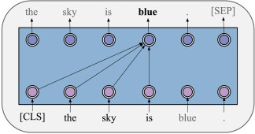
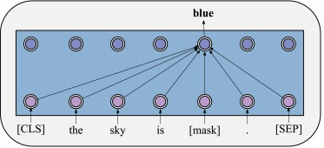
Fragmented AI – reproduction way
Prediction process of GPT
Prediction process of BERT

Slide 27
Fragmented AI – self-thinking way
Recall that self-thinking way is being represented by artificial general intelligence (AGI). I introduce AGI here. Deep neural network (DNN) is current trend and current popular implementation of artificial neural network, which simulates human neural network including nerve cells and synapses. Electric signals are modeled as propagation rule and weight updating rule built in DNN whose skeleton/structure quantified by weights is trained from data. In other words, DNN is infrastructure of artificial intelligence (AI), which is corresponding to human brain.
However, human intelligence also includes another aspect that is reasoning ability to produce new knowledge as well as another aspect that is self-learning and self-training. DNN can produce new knowledge too by its subdomain that is generative artificial intelligence (GenAI) but GenAI needs data to train itself as well as GenAI must be structured by specific parameterized models like any DNN applications.
Therefore, artificial general intelligence (AGI) can open a new sky for AI if some AI applications or AGI applications can train themselves without predefined and restricted parameters, which leads to an excellent result that an AGI application may solve an unknown problem which is the problem that it does not know yet before. Moreover, data is not so essential to AGI because AGI has self-learning mechanism.
For easy explanation, AI or narrow AI for specific goals is infrastructure and AGI is high-level architecture (superstructure) so that narrow AI and AGI are developed mutually and symbiotically. This relationship is similar to the relationship between human brain and human reasoning. Narrow AI which is referred here as a focus group of AGI and narrow AI models are often mentioned as DNN applications although DNN is subdomain of narrow AI.

Slide 28
Fragmented AI – self-thinking way
Artificial general intelligence (AGI) may be a piece of industry 4.0, which follows and asserts features of knowledge-based economy. But what is implication?
AGI may not be a piece of industry 4.0 because it belongs to science as well as technological methodology, which does not focus on profits and benefits. But what is implication?
Exactly, although maybe AGI may not be an exact representation of human consciousness, it implies the trend of human consciousness where human intelligence is not still enclosed by human brain (by new consciousness) even though human brain and its abilities and potential are not comprehended yet in a very long discovery journey.
Exactly, AGI implies a (future) significant evolution of human spirit that is spirit evolution, when physical evolution might be stopped for a very long time ago.
But why AGI implies the future spirit evolution? I can have only one answer that human intelligence is not still enclosed by human brain, for instance, the huge data over human history is being trained by Chat GPT, which makes a huge number of connections as the infrastructure playing the role of new huge brain on which AGI makes its reasoning and self-education.

Slide 29
Marvelous biology
Deoxyribonucleic acid (DNA) stores biological information called genetic code which plays a role of genetic instructions for synthetizing proteins of all living organisms. Because any living organism is special kind of matter, that ADN is information derives an inference that information is property of matter. However, within the unification of matter and spirit, information is matter as well as spirit too. Exactly, information is part of matter as well as matter consists of information and other things. If data is considered as information within the unification of matter and spirit, information is assuredly both matter and spirit.
Please pay attention to two statements: 1) any living organism is special kind of matter, and 2) information is part of matter, with note that information is main subject of informatics. This implies biology mixes physics and informatics together.
There are connections among philosophy, math, physics and informatics. These connections are realized by biology as well as biology reflects these connections. Moreover, biology is an perfect implementation of physics and informatics and we cannot find out another perfect implementation. Therefore, biology is marvelous.
Holography, a technique of physics and computer science, allows to reconstruct 3D scene from hologram stored as computer files. Hologram is an version of DNA within context of inorganic things.

Slide 30
Marvelous biology
Recall that AI inherits knowledge from three sources: 1) knowledge from applied math, 2) knowledge/wisdom from nature, and 3) predefined assumption called heuristic assumption from human. The second source from nature is provided by biology, for example, artificial neural network (ANN) simulates human nervous system.
Not only living organisms but also social activities in biological world are applied into AI. While ANN is an example of simulating living organisms, swarm intelligence is an example of applying social activities. Particle swarm optimization (PSO) algorithm was developed by James Kennedy and Russell C. Eberhart is an AI algorithm belonging to swarm intelligence. The main idea of PSO is based on social intelligence when it simulates how a flock of birds search for food. Although it is too difficult for only one bird to find out food source, many birds in a flock can find out easier food source when they contact and share information about searching process together.
In general, there are many AI algorithms that simulate or model biological world and so, these algorithms are grouped into a sub-field of AI called evolutional programming which includes: ANN, PSO, genetic algorithm (GA), etc.

Slide 31
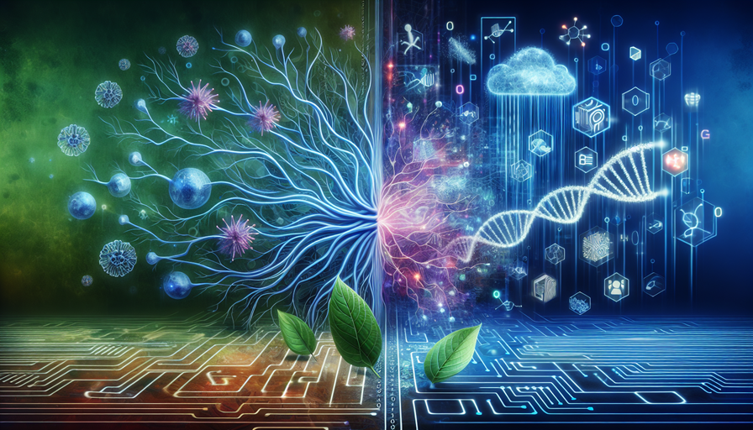
Marvelous biology
Biology meets AI - Alayna

Slide 32
Marvelous biology
Recall that one of knowledge sources that AI inherits is knowledge source from nature or biological world. However, biology is much more marvelous than what AI inherited by simple way because one of important aspects of living organism is ability of reproduction fitness when reproduction fitness is the first and most important step of evolutional process.
Recall that the convergence process of AI is going according two ways such as reproduction way and self-thinking way. reproduction way is being represented by generative AI (GenAI). Therefore, GenAI reflects reproduction fitness of biological world.
I think that AI cannot be as intelligent as human unless AI can evolve itself as living organism. It is possible to imply that GenAI may give AI the ability of reproduction fitness so that AI may evolve as living organism. In other words, GenAI incorporated with other unknown aspects may help AI to be as intelligent as human.
But why GenAI itself may not help AI to be as intelligent as human (at least, GenAI is not enough)? The answer is that another important aspect of human intelligence is self-consciousness and there exist many other aspects too. Note, self-consciousness can be simulated by ability of self-thinking. Fortunately, self-thinking way of AI is being represented by artificial general intelligence (AGI). Unfortunately, there are not significant / important achievements / technologies in AGI now (2024) yet.

Slide 33
Mysterious God
Back to swarm intelligence with an AI example of particle swarm optimization (PSO) algorithm which simulates how a flock of birds search for food, it is possible to give explanations about the dual of complexity and intelligence. However, why the dual of complexity and intelligence occurs? One of most reasonable answers is that there is an invisible force that motivates everything. Adam Smith, an British economist, proposed a theory of invisible hand, in which the economy will be developed automatically if everyone make profits for themselves even without concerning such entire economy. Such invisible hand implies the possibility of existence of God and of course, God is mysterious.
There are many natural phenomena that are from simple to complicated and the number of these phenomena is infinite but we can guess that there must be a/some topmost phenomena because some contradictions may occur if the number of these phenomena is finite. As a result, the topmost phenomena called supernatural phenomena can be ultimate principles or God or the assumption that we must agree the unity of everyone in self-consciousness. Such assumption is mentioned as unification of matter and spirit. Anyhow, God is mysterious.
Under mysterious God, there is no clear borders among philosophy, math, informatics, and biology.

Slide 34
Great Nature
Biological world is the subset of Nature when Nature consists of both organic matter and inorganic matter. Moreover phenomena can be classified as natural phenomena. Therefore, it is possible to assume that Nature includes matter world and spirit world. As a result, Nature is great.
Is Nature equivalent to God, ultimate principles, or the unity of everyone? There is no answer because God is mysterious, which only asserts again that Nature is great. It is only possible to state that Nature is great because God is mysterious and vice versa, God is mysterious because Nature is great (this is implicitly true).
Recall that AI inherits knowledge from three sources: 1) knowledge from applied math, 2) knowledge/wisdom from nature, and 3) predefined assumption called heuristic assumption from human. Because of great Nature, the three sources are contained in Nature. As a result, backing to the question “whether AI can evolve itself as living organism”, the answer may be possible or opened at least due to two reasons: 1) Nature is great, includes matter world and spirit world, and 2) the hint of reproduction way and self-thinking way followed by convergence process of fragmented AI.

Slide 35
Valiant physics
Recall that because there exists invisible force in Nature as well as the number of natural phenomena is infinite, we must accept one among two following assumption: 1) existence of God, or 2) existence of ultimate principles. By the power of valiant physics, especially by current works of quantum theory and dark energy theory, it is hopeful that physics will give more explanations about Nature and universe.
In recent research, I propose the unification of matter and spirit which means that there is no separation between matter and spirit (Nguyễn, 2024). All things are named idea which represents both matter and spirit. Of course, idea was proposed by many philosophers like Plato and Hegel. However, my proposal is that when all things are ideas, each idea “is”, “lives in”, “imagine in” a own copy of the world and each copy is real as well as unreal. Each copy likes a bubble. Only ego (everyone) as an idea justifies her/his existence by herself/himself and such existence justification spreads and transforms into other existence justifications for countless other ideas but other idea bubbles do not exist (are unknown) with regard my ego. This is theory of idea whose center point is that matter is spirit and spirit is matter too.
Within theory of idea, the existence self-justification of idea bubble is continuous but the self-consciousness of human is discrete because human epistemology is realized only if it is discrete. As a result, the aspect “abstraction of things” of math is discrete too, indeed. Therefore, discretion of informatics indicates strong relationship among philosophy, math, physics, and informatics.
Theory of idea is the third assumption that we can accept among: 1) existence of God, 2) existence of ultimate principles, or 3) unity of human as idea bubble with continuous self-justification.

Slide 36
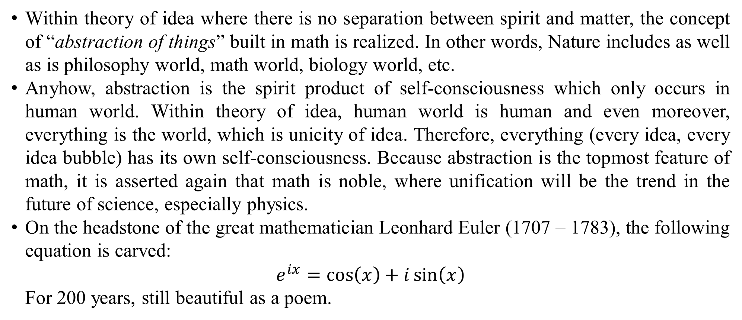
Noble math
Within theory of idea where there is no separation between spirit and matter, the concept of “abstraction of things” built in math is realized. In other words, Nature includes as well as is philosophy world, math world, biology world, etc.
Anyhow, abstraction is the spirit product of self-consciousness which only occurs in human world. Within theory of idea, human world is human and even moreover, everything is the world, which is unicity of idea. Therefore, everything (every idea, every idea bubble) has its own self-consciousness. Because abstraction is the topmost feature of math, it is asserted again that math is noble, where unification will be the trend in the future of science, especially physics.
On the headstone of the great mathematician Leonhard Euler (1707 – 1783), the following equation is carved:
$$e^{ix}=\cos\left(x\right)+i\sin\left(x\right)$$
For 200 years, still beautiful as a poem.

Slide 37
References
Han, X., Zhang, Z., Ding, N., Gu, Y., Liu, X., Huo, Y., . . . Zhu, J. (2021, August 26). Pre-trained models: Past, present and future. AI Open, 2(2021), 225-250. doi:10.1016/j.aiopen.2021.08.002
Nguyen, L., Abdalla, H. I., & Amer, A. A. (2024, August 28). Adversarial Variational Autoencoders to Extend and Improve Generative Model. (T. Sands, Ed.) AI, Computer Science and Robotics Technology (ACRT), 3(1). doi:10.5772/acrt.20240003
Nguyễn, L. P. (2024, October 24). Học thuyết ý niệm và triết học pháp quyền. ResearchGate Preprint, 1-11. doi:10.13140/RG.2.2.25462.20807
Oussidi, A., & Elhassouny, A. (2018). Deep generative models: Survey. 2018 International Conference on Intelligent Systems and Computer Vision (ISCV). Fez, Morocco: IEEE. doi:10.1109/ISACV.2018.8354080
Vaswani, A., Shazeer, N., Parmar, N., Uszkoreit, J., Jones, L., Gomez, A. N., . . . Polosukhin, I. (2017). Attention Is All You Need. In I. Guyon, U. Von Luxburg, S. Bengio, H. Wallach, R. Fergus, & S. Vishwanathan (Ed.), Advances in Neural Information Processing Systems (NIPS 2017). 30. Long Beach: NeurIPS. Retrieved from https://arxiv.org/abs/1706.03762

Slide 38
Thank you for listening

